Slide 1
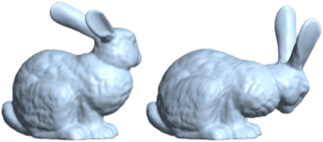
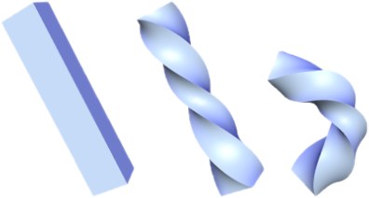
Mesh Representation: Linear Rotation-invariant Coordinates for Meshes
Speaker: Tianle Yuan (Mark)

Slide 2
Outline
I. Self Introduction
II. Project Topic
III. Time Schedule
IV. Challenges
V. Plans to tackle difficulties
VI. Q&A

Slide 3
I. Self Introduction

Slide 4

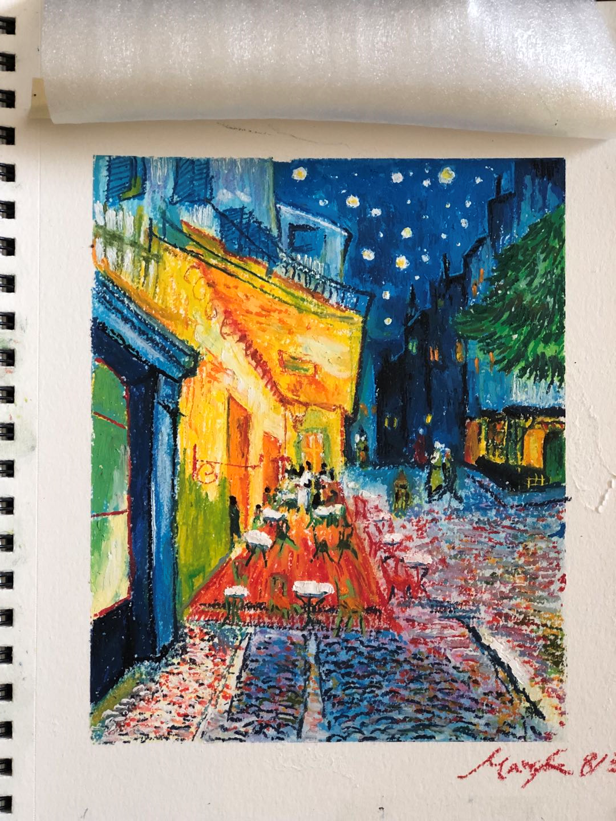
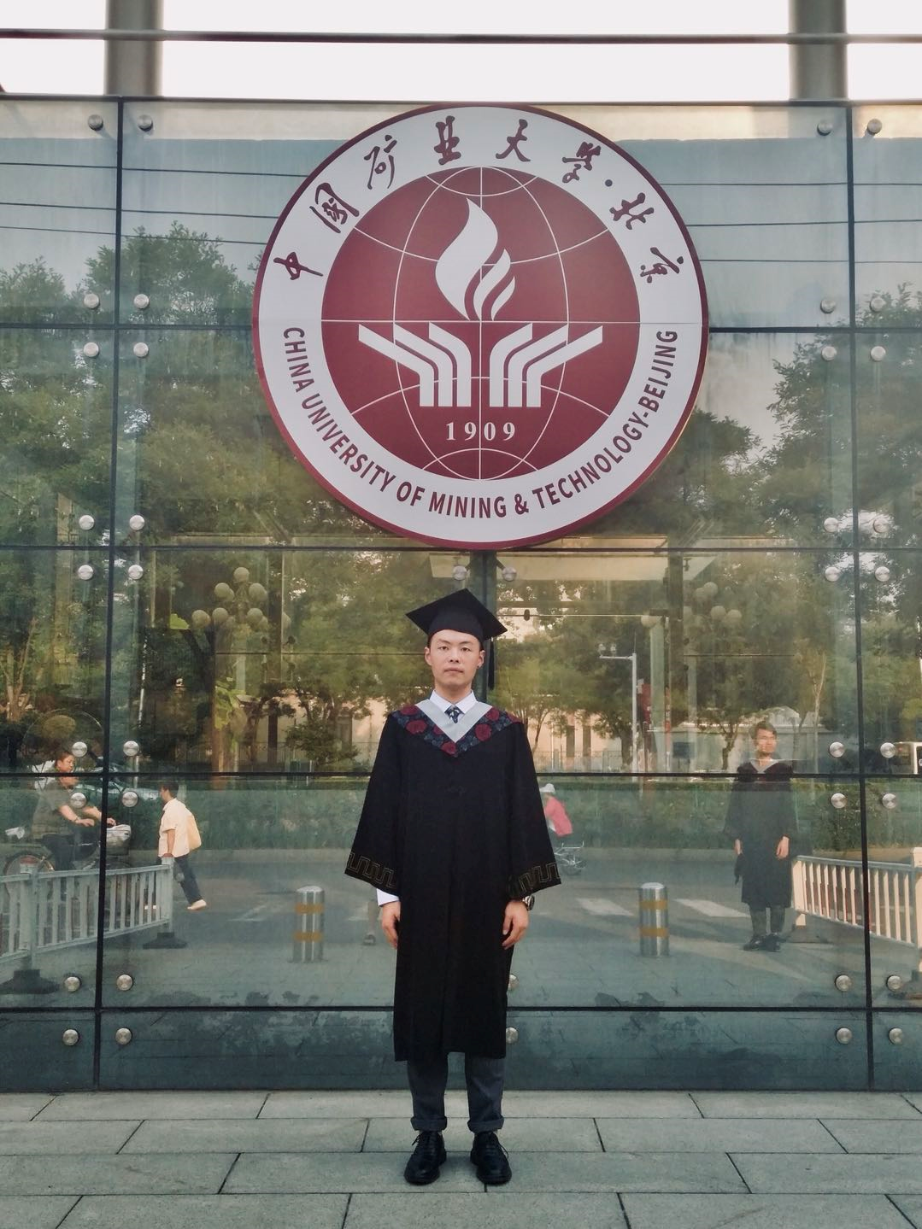
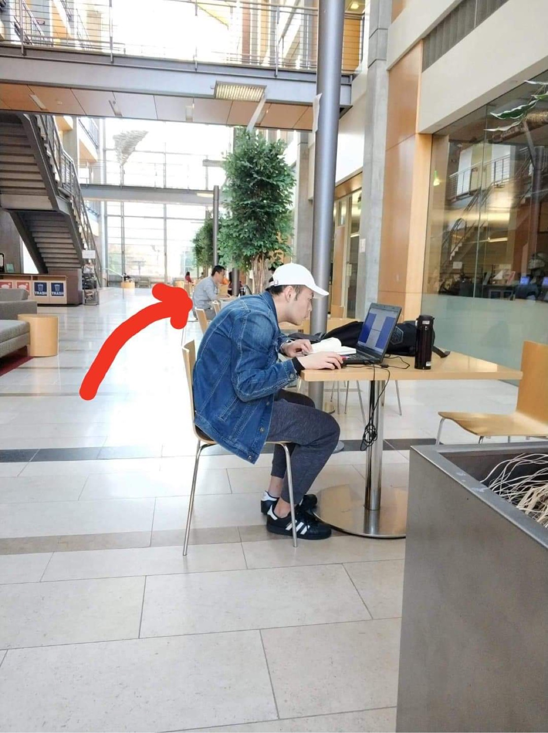

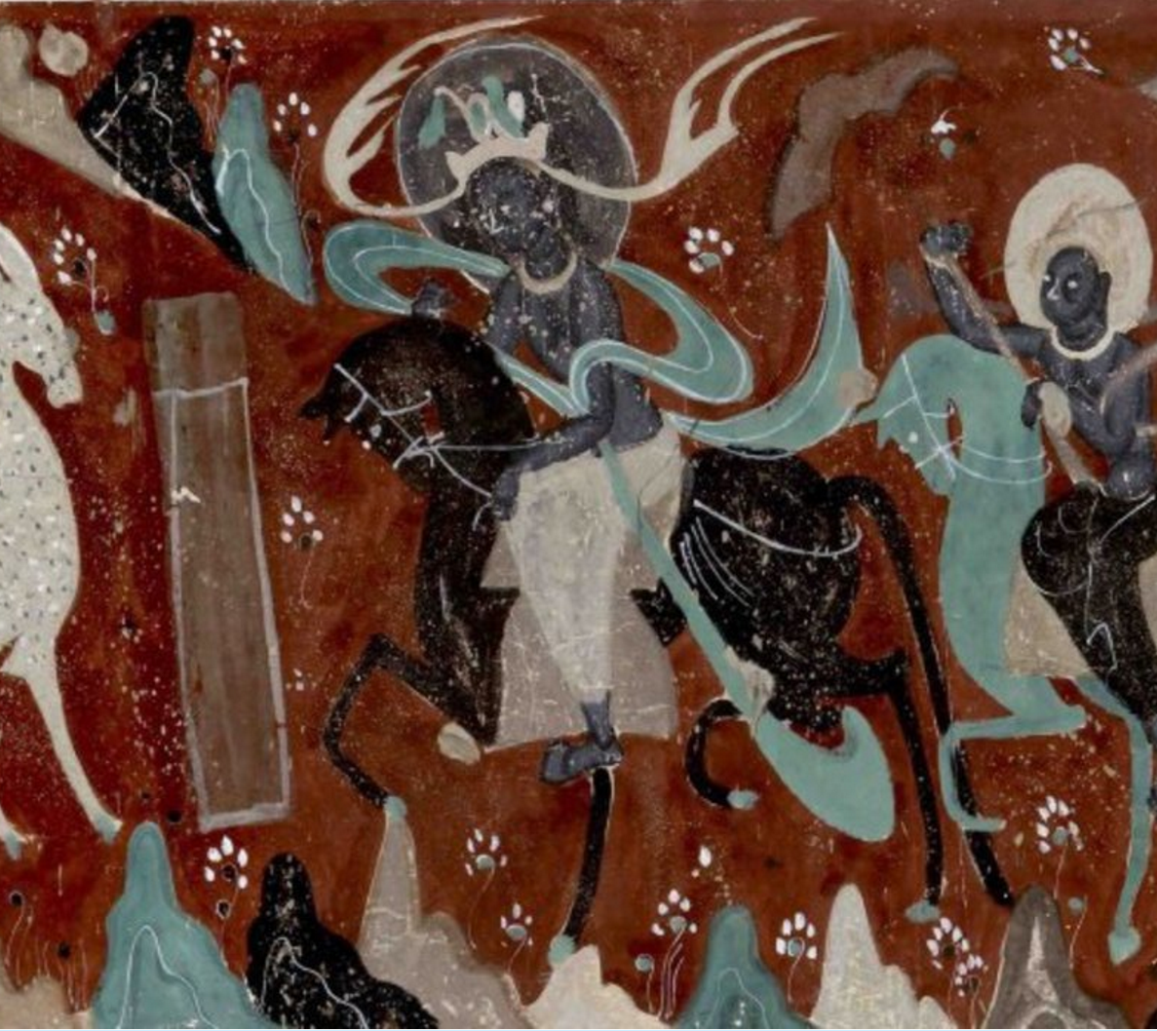
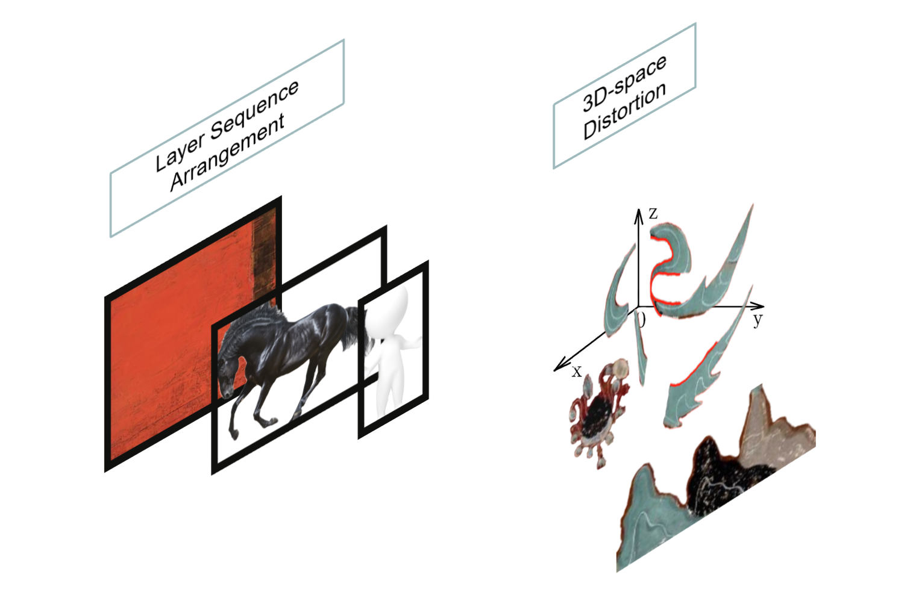
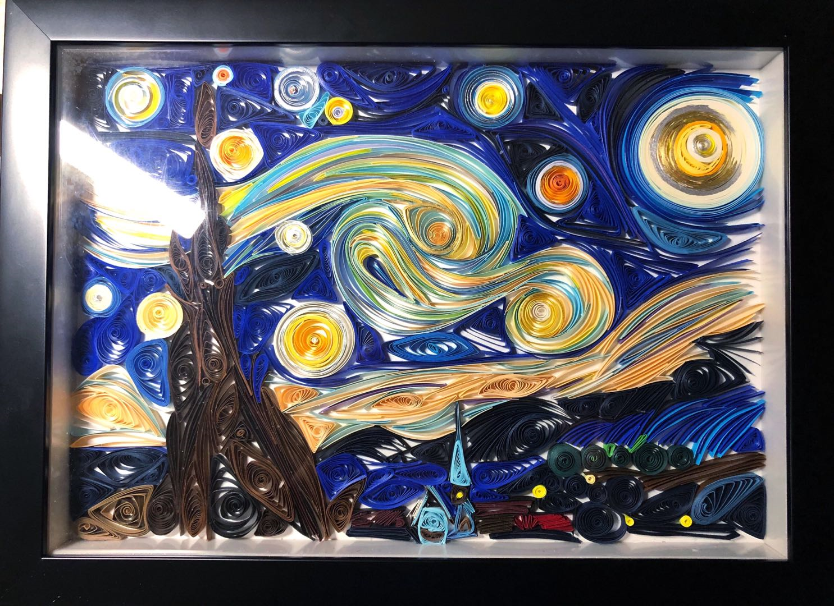
I. Self Introduction
My name is Tianle Yuan (Mark)...
My research...
About me:
Hobbies never end...

Slide 5
II. Project Topic

Slide 6
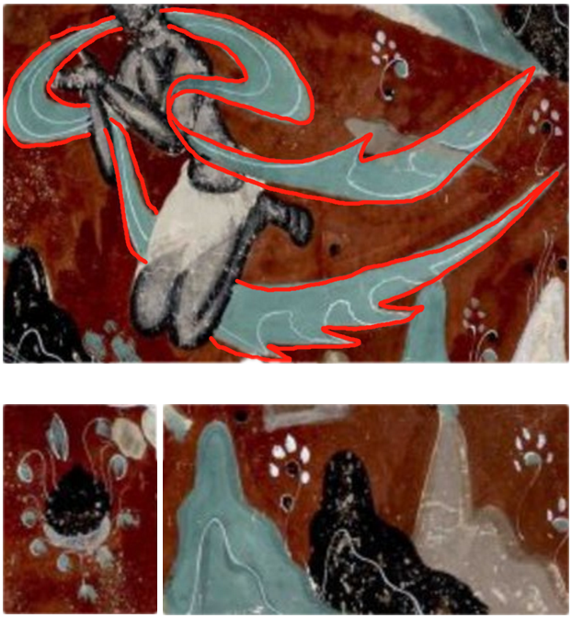
II. Project Topic
What is the Mesh Representation?
What is the technique used for?
What is the topic?
A Mesh Representation: Linear Rotation-invariant Coordinates for Meshes
Mesh geometry deformations.
Like what we learnt before: Verts, Edges, Tris, Corners...
We try to give the geometry mesh new attributes for problem solving.

Slide 7
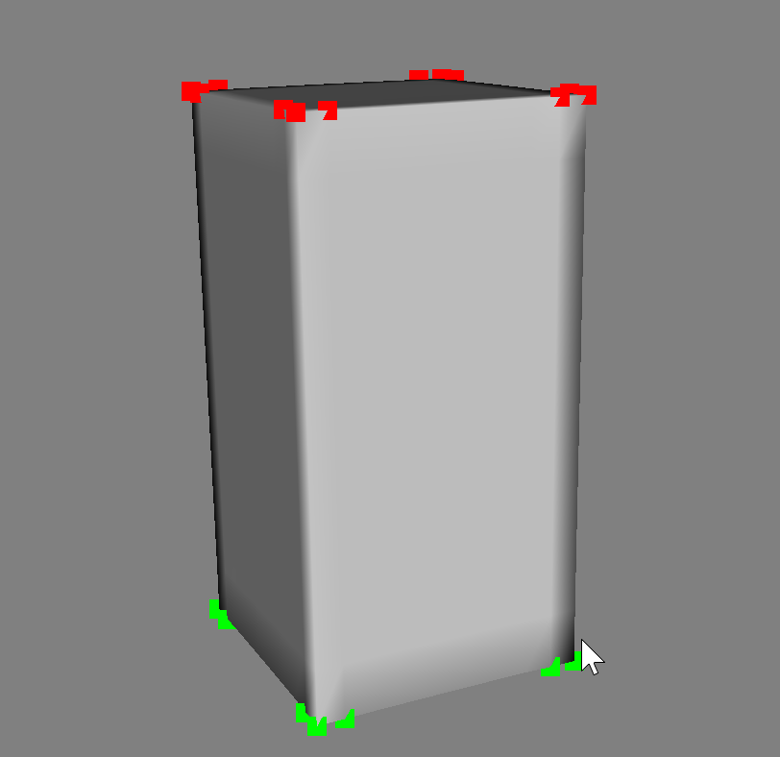
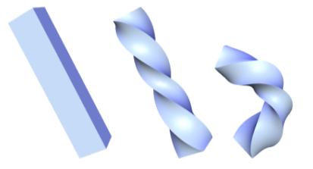
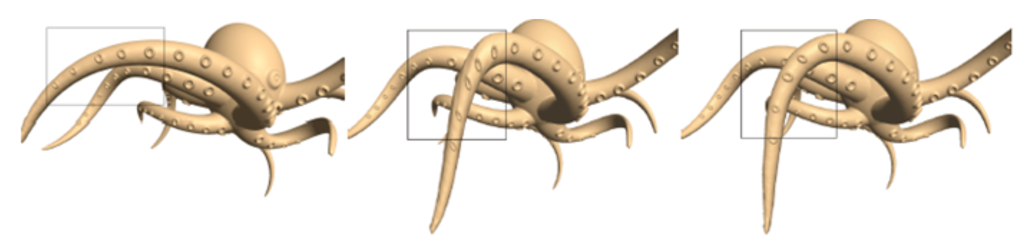
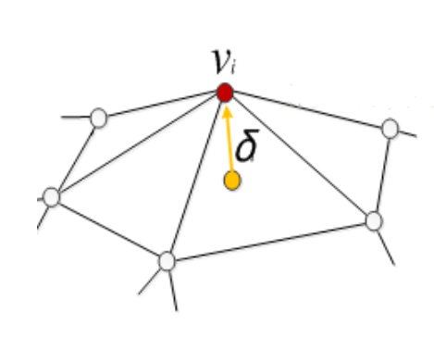
II. Project Topic
What is the Problem of previous techniques?
Let's see typical techniques of mesh deformations: Laplasian Deformation
Laplasian vector for a vertex do not rotate when the it's position changed according to the rotation.

Slide 8
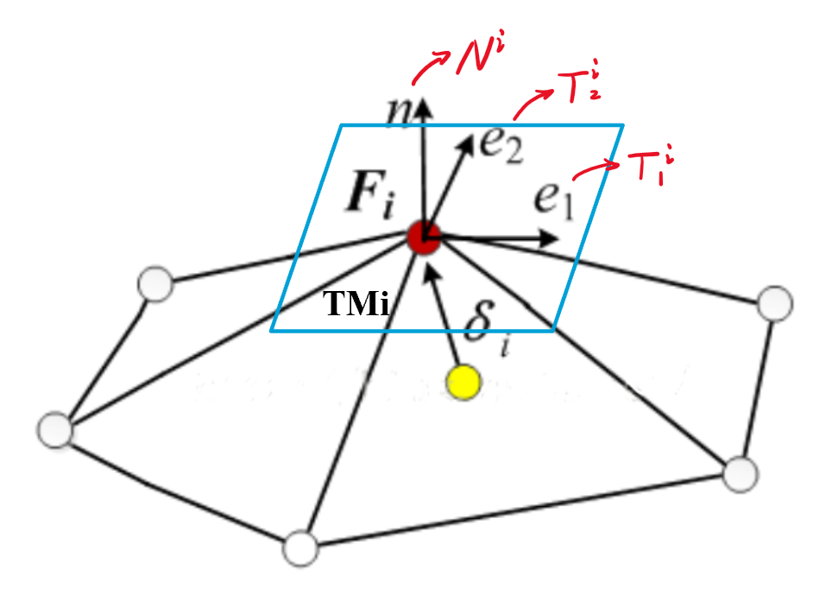
II. Project Topic
So, how does the Mesh Representation help us to solve the Problem of Laplasian method?
For each vertices, we set a Discrete Frame, which is:
F^{i} = (T^{i}₁, T^{i}₂, N^{i}) or (b^{i}₁, b^{i}₂, N^{i})

Slide 9
III. Time Schedule

Slide 10
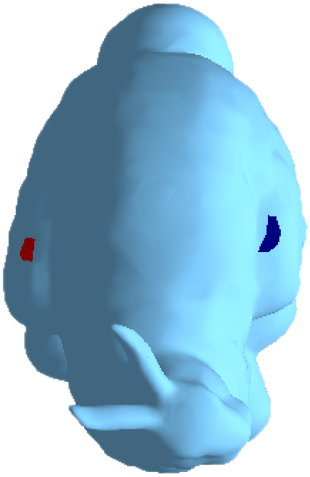
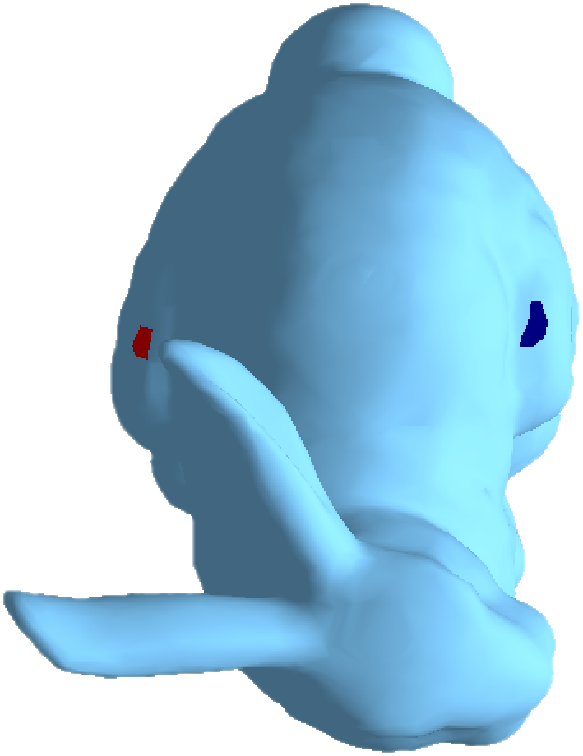
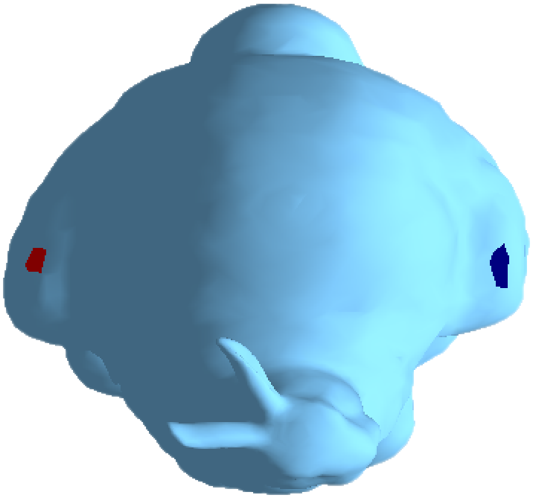
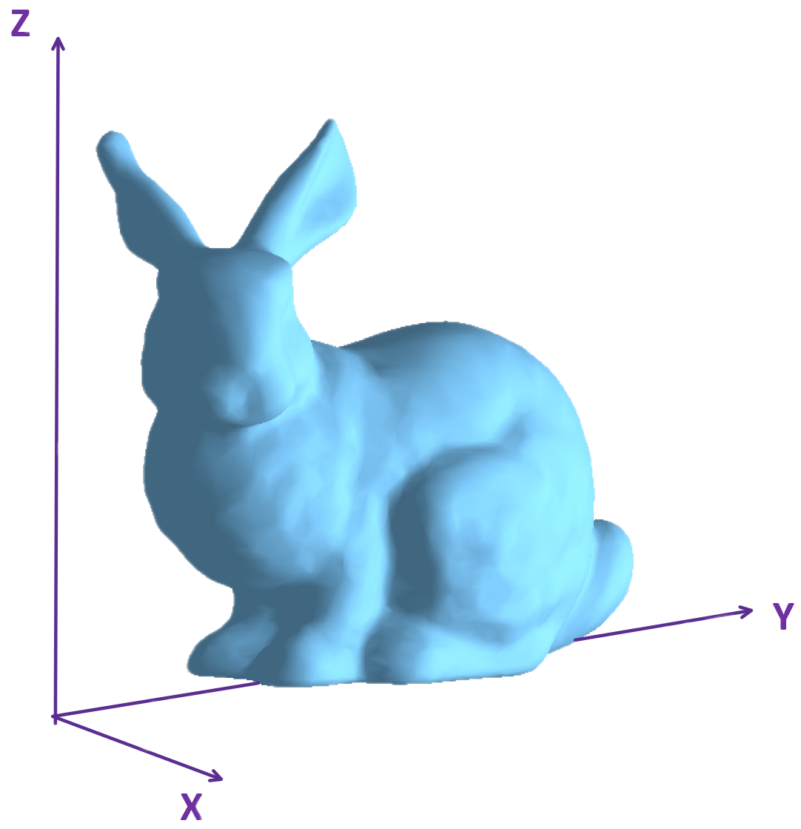
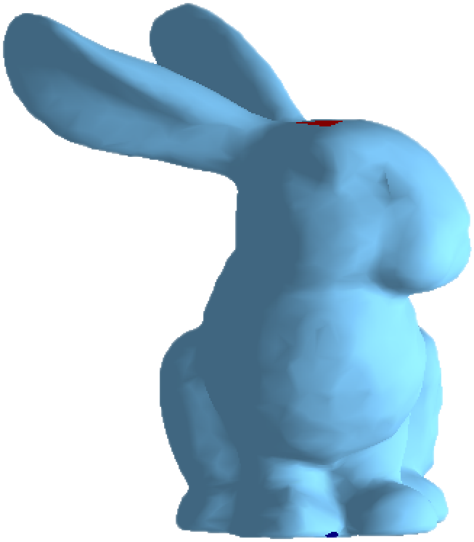
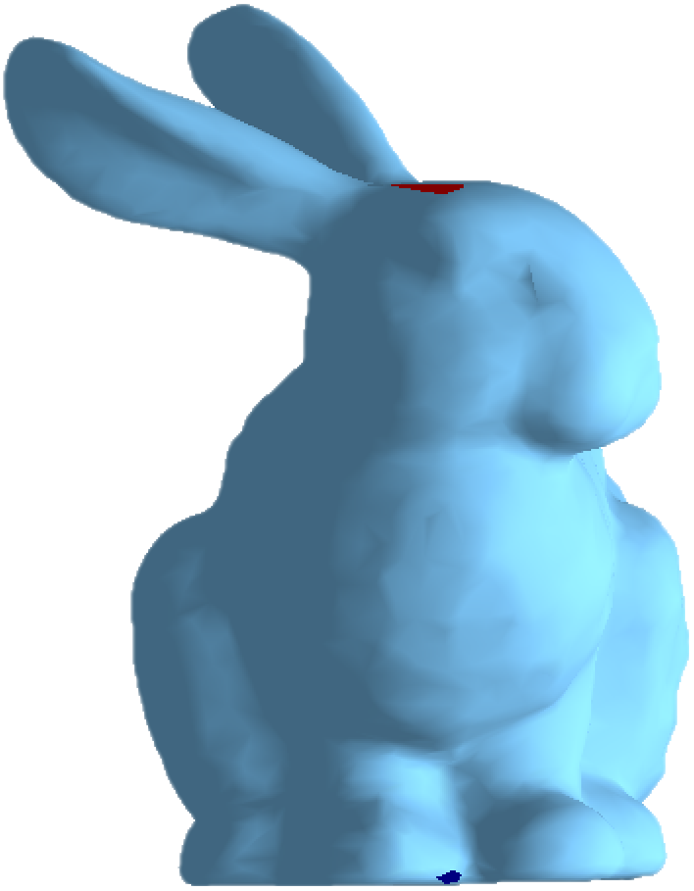
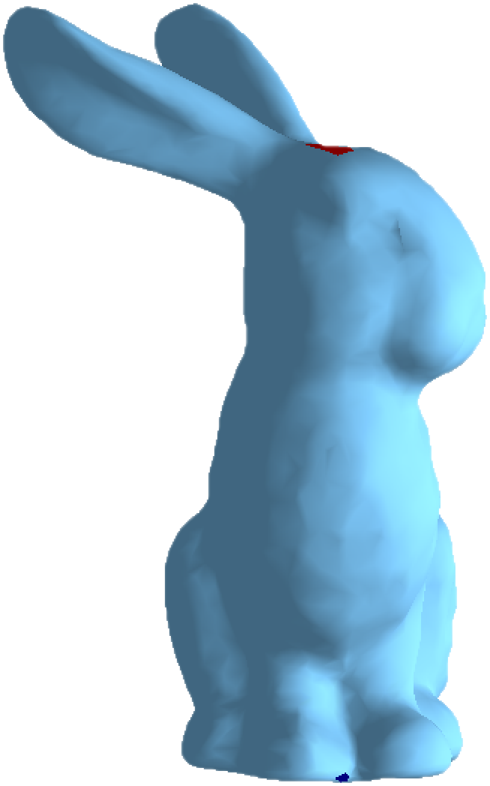
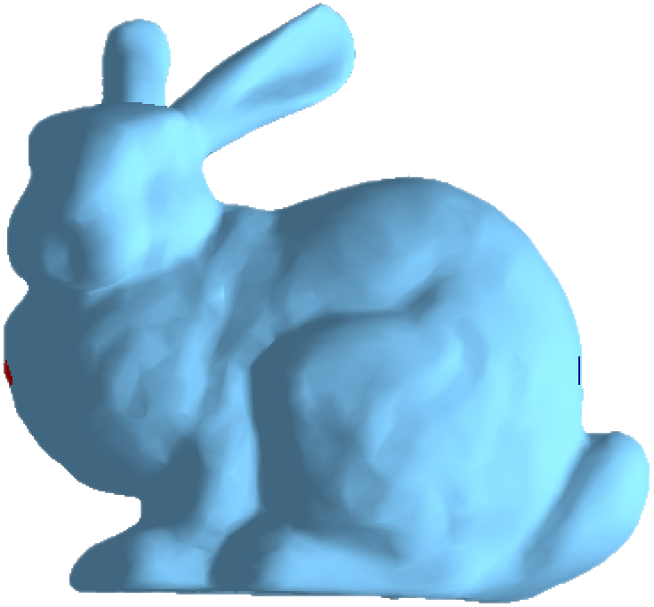
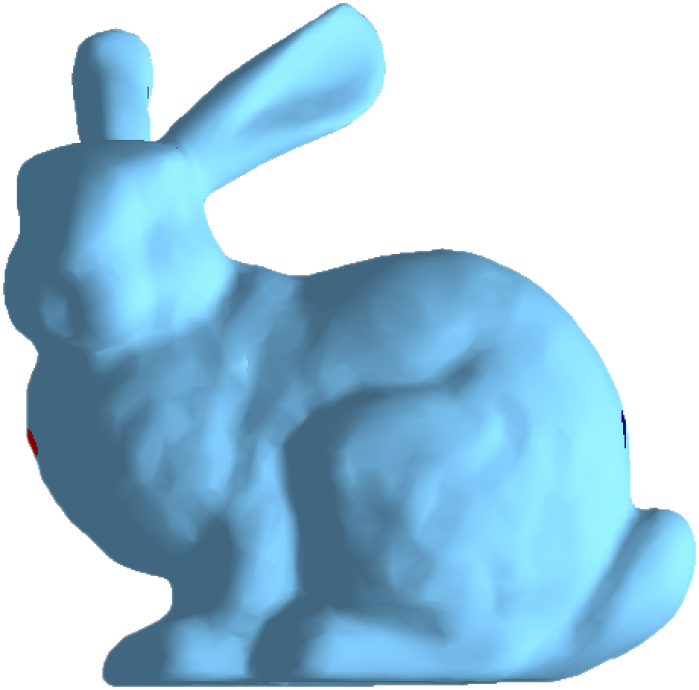
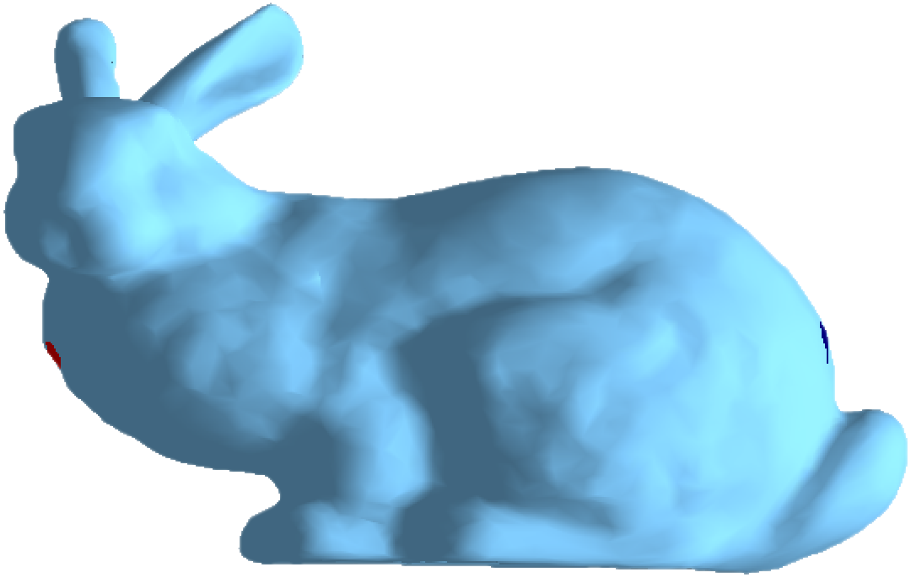
III. Time Schedule
Translation
3.1-3.8 Basically finished construction of a frame of the
two overconstrained equation system.
△x - 0.3
△x + 0.3
△z - 0.3
△z - 0.3
△z + 0.3
△y - 0.3
△y + 0.3

Slide 11
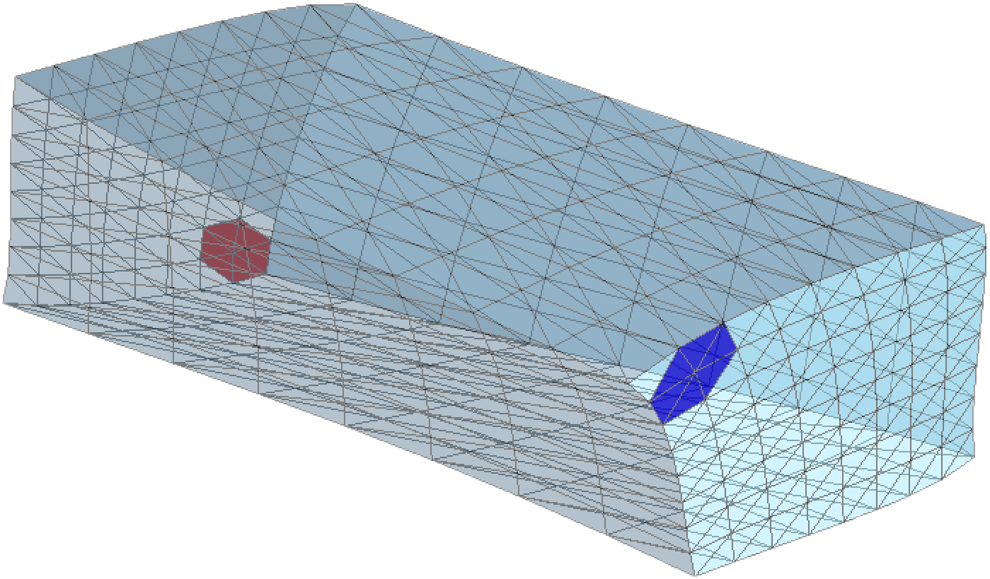
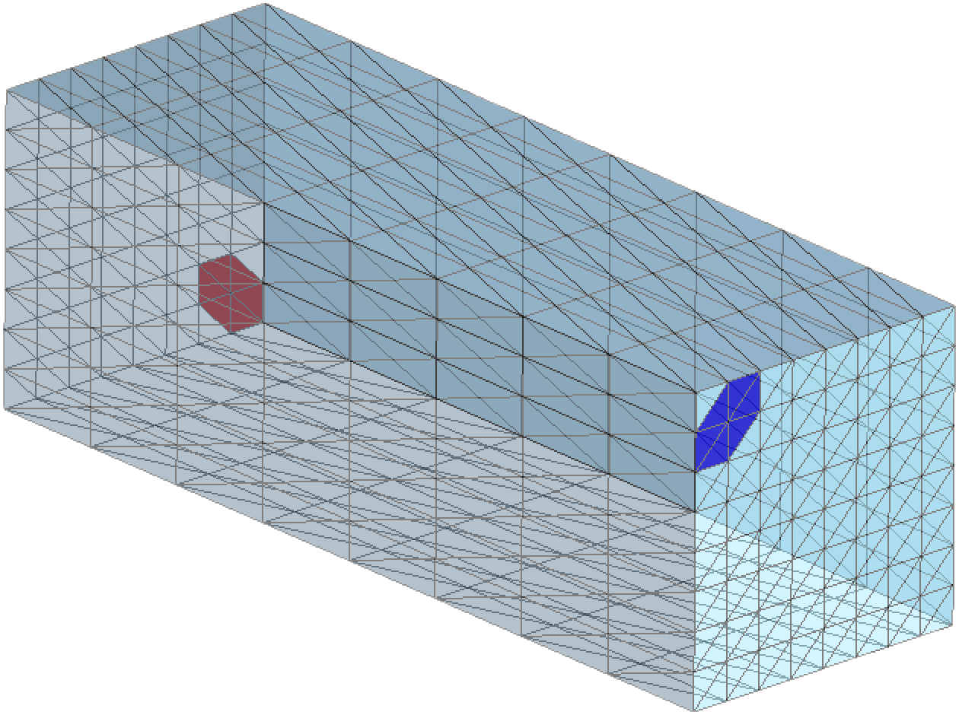
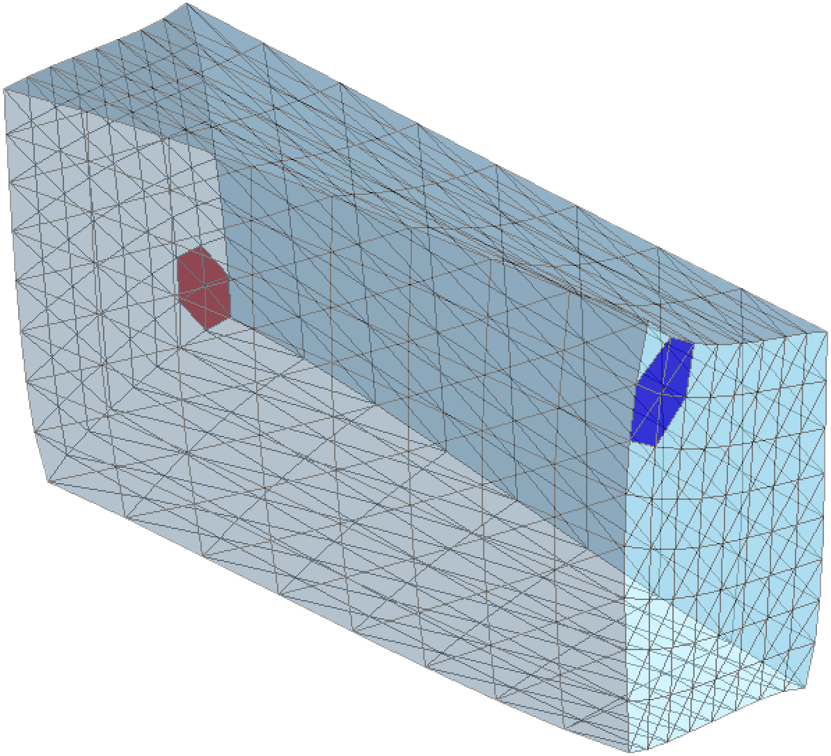
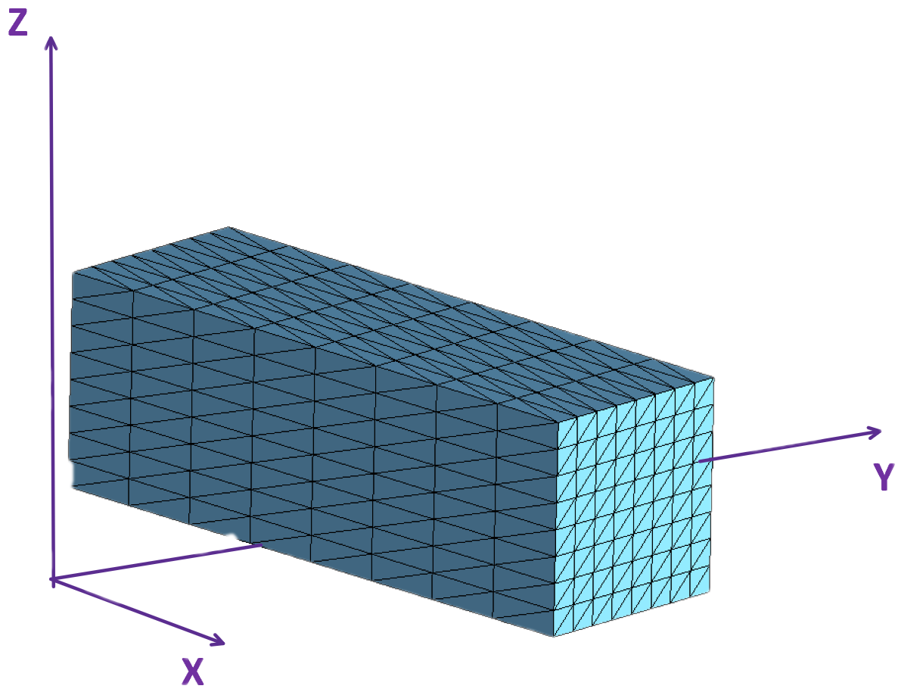
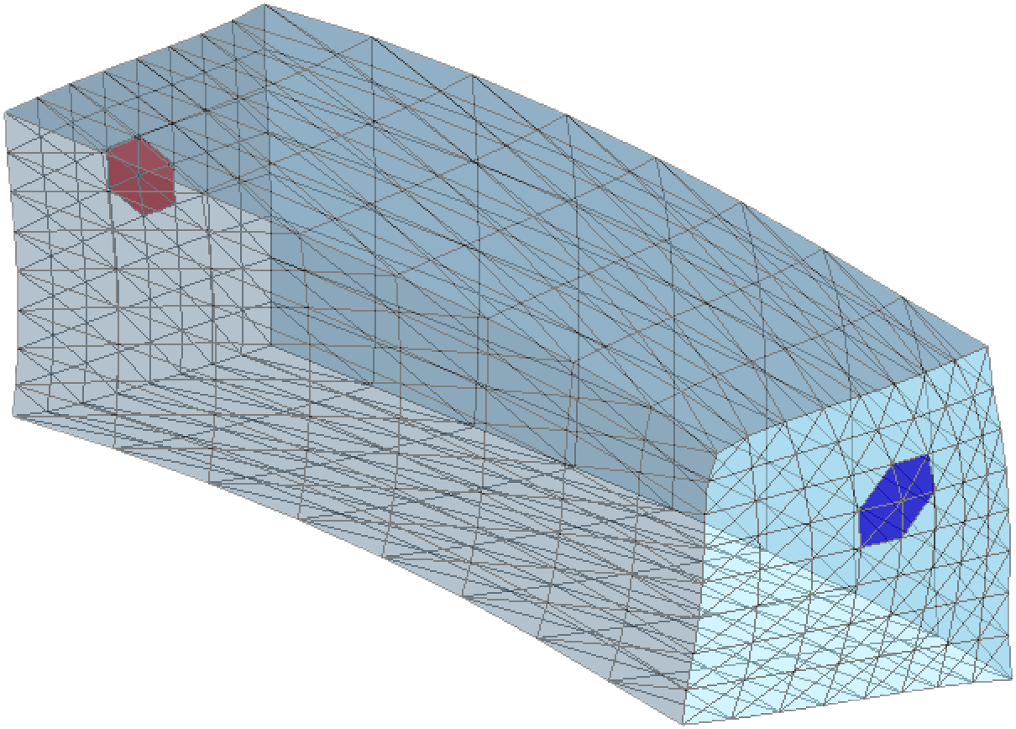
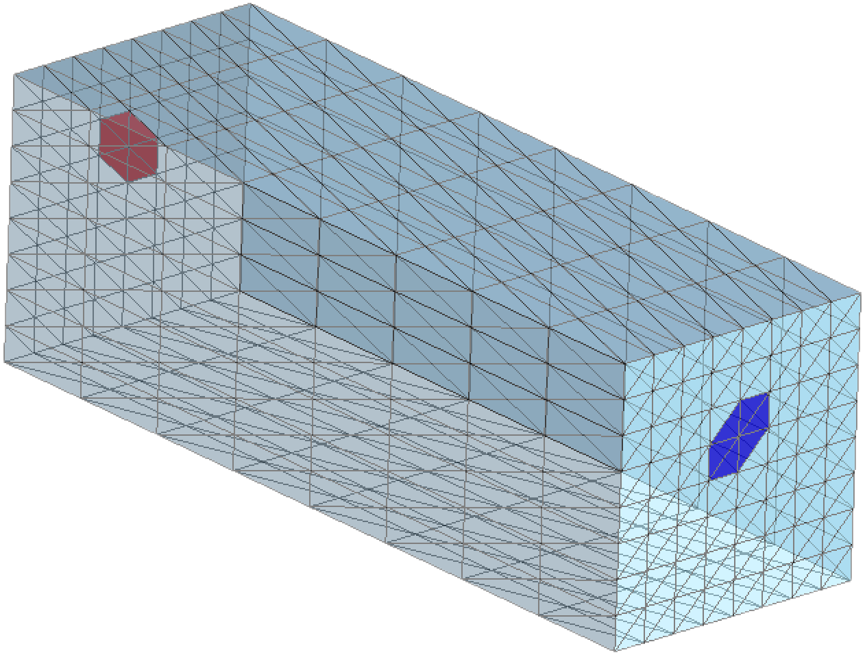
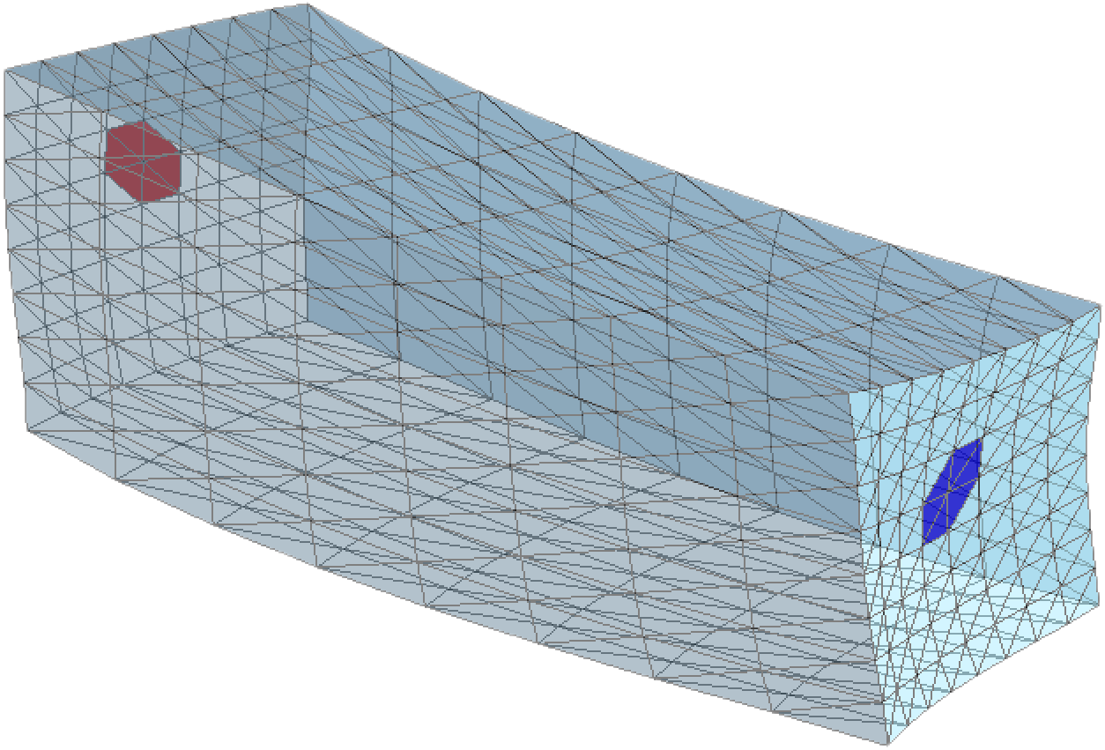
III. Time Schedule
Rotation
3.1-3.8 Basically finished construction of a frame of the
two overconstrained equation system.
φx - PI/6
φx + PI/6
φz - PI/6
φz + PI/6

Slide 12
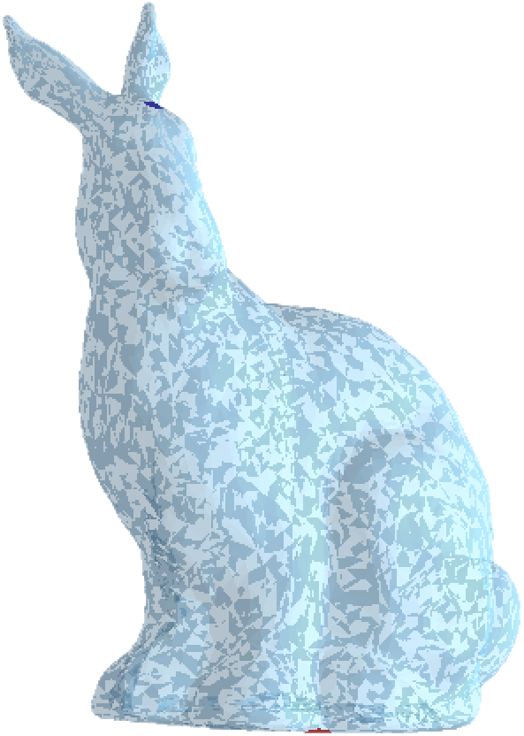
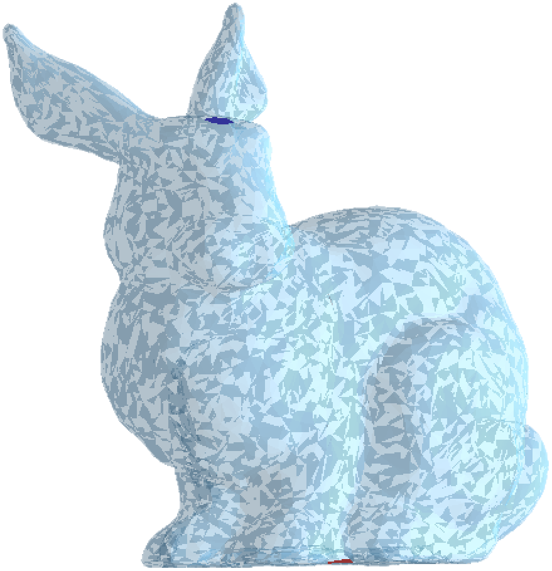
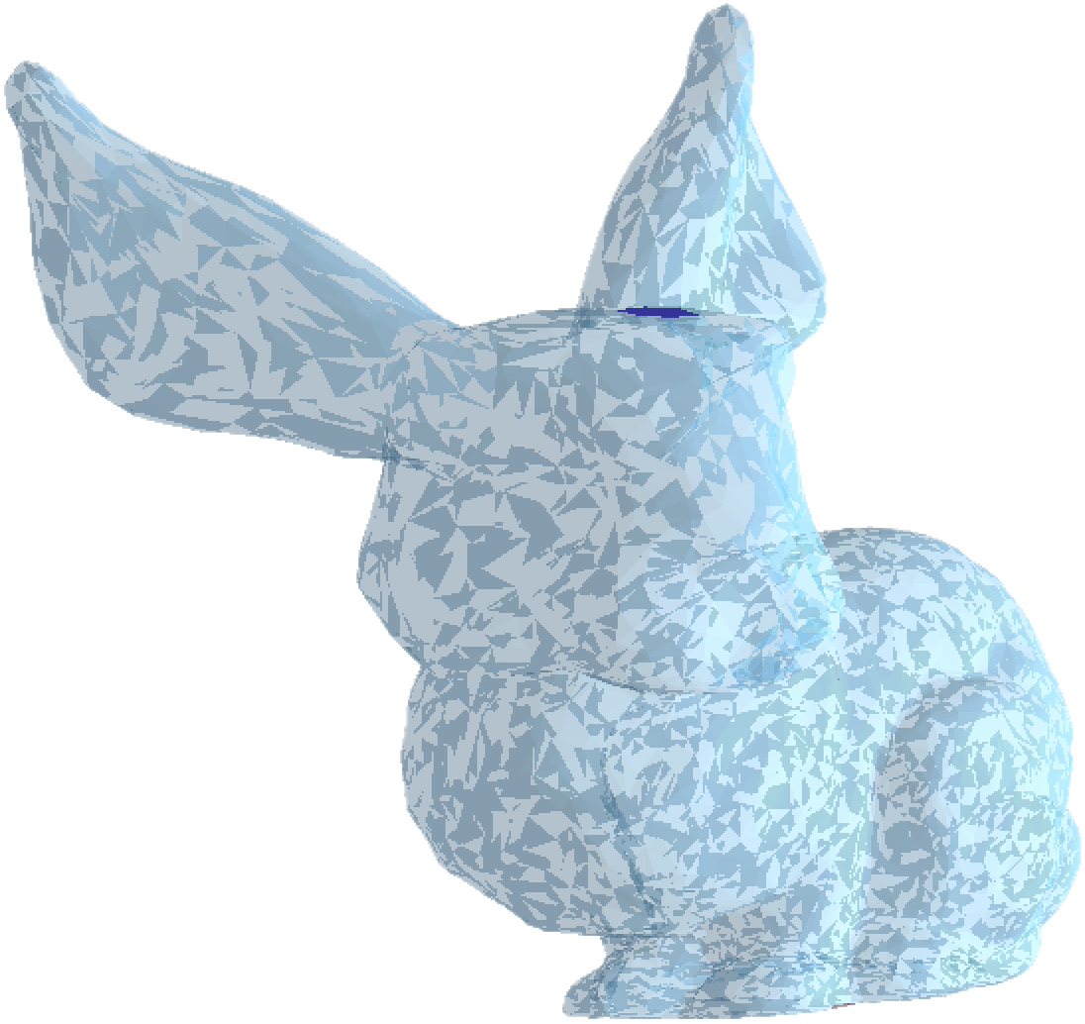
III. Time Schedule
Scale
3.1-3.8 Basically finished construction of a frame of the
two overconstrained equation system.
S_{p} = 0.5
S_{p} = 2.0

Slide 13

III. Time Schedule
3.9-3.18 Going to increase the number of constrain points for a better Rotation-invariant results.

Slide 14
III. Time Schedule
3.9-3.18 Going to increase the number of constrain points for a better Rotation-invariant results.

Slide 15
IV. Challenges

Slide 16
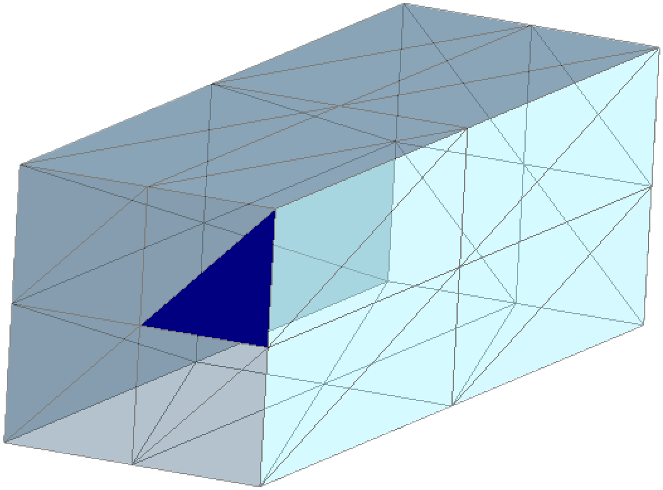
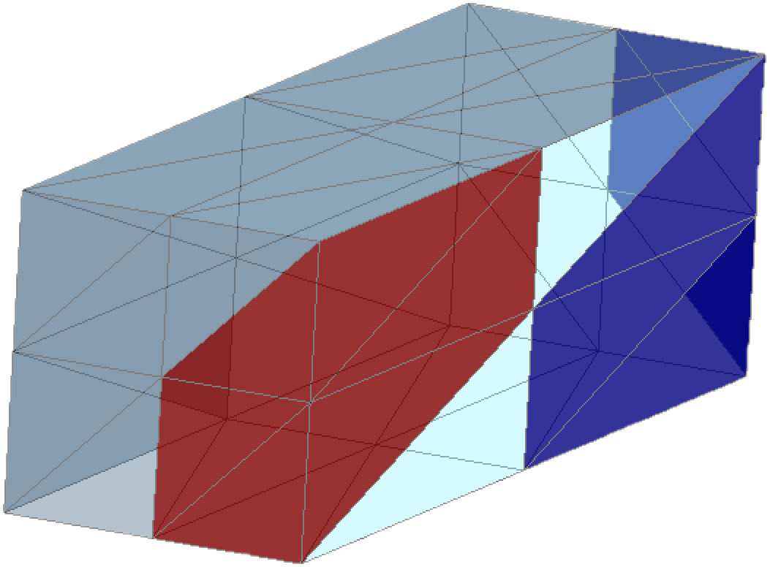
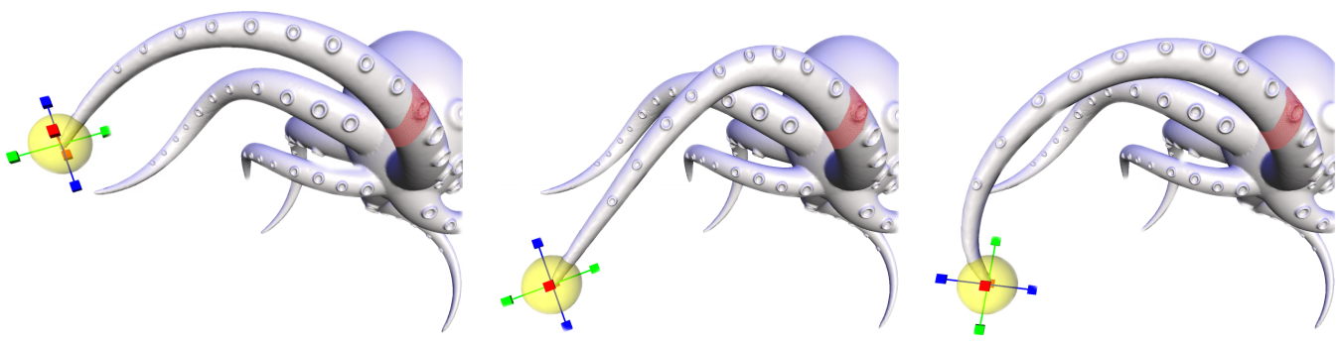
IV. Challenges
The Problem of constrain point choosing.
The Problem of the complex UI interactions.
The Problem of the calculation speed.
Two large linear equation system with least square method

Slide 17
V. Plans to tackle difficulties

Slide 18
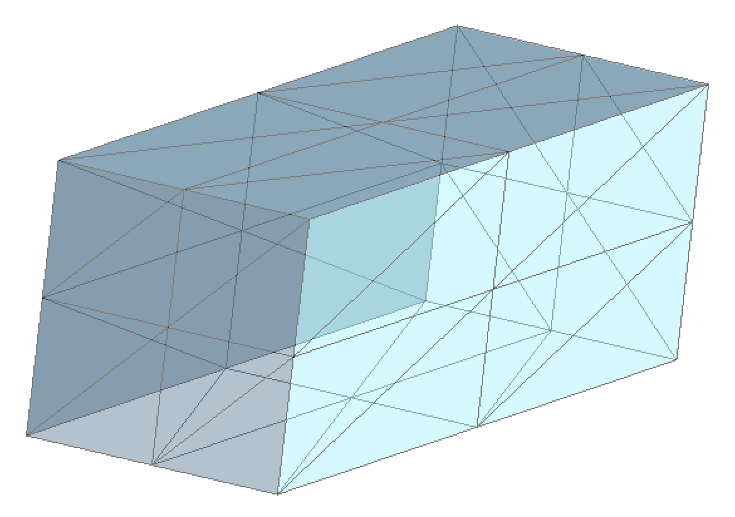
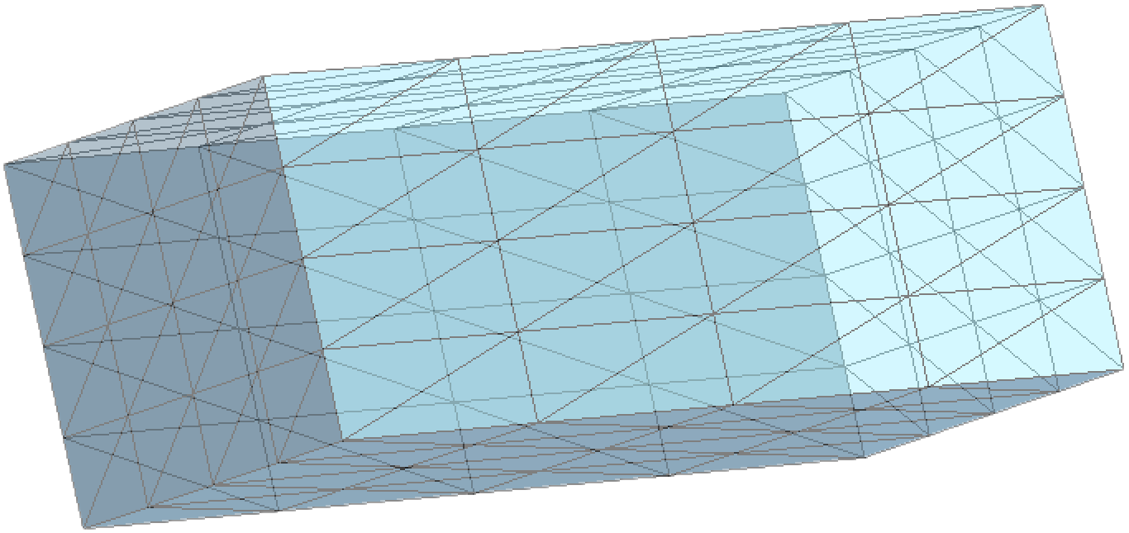
V. Plans to tackle difficulties
The Problem of constrain point choosing.
I will go to hint two alternate triangles, which are all the neigbours of the vertex, to locate the vertex I want.

Slide 19
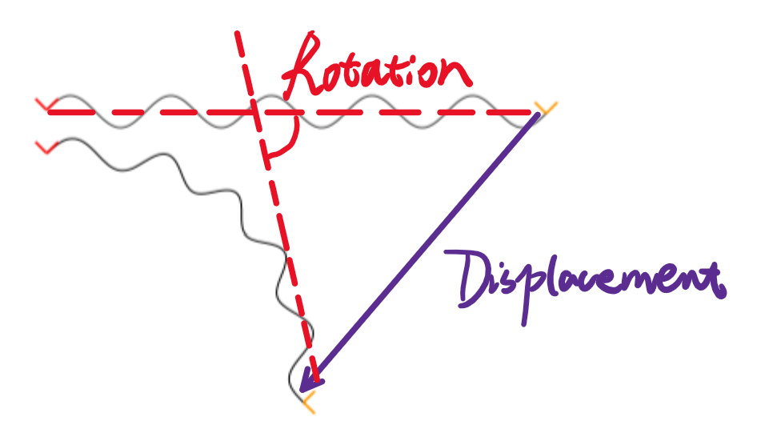
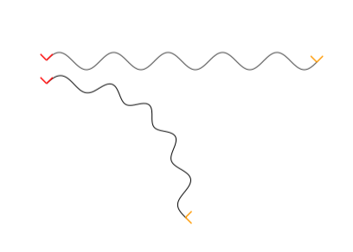
V. Plans to tackle difficulties
The Problem of the complex UI interactions.
Try to move the control points in the direction of vectors paralleling to the screen plane.
Rotate angles need to be set ahead by considering the displacement conditions.
Try to keep the Positional Constrain and the Transformation Constrain competible or the shape will shear.

Slide 20
V. Plans to tackle difficulties
The Problem of the calculation speed.
Two large linear equation system with least square method
Will change all the matrix into a format of sparse matrix to save time of elements loading.
Ignore all the process before the deformations.
Save all the constant variables in GPU for next display circle.
Parallel processing...

Slide 21
VI. Q&A

Slide 22
Thank you !

